Slide 1

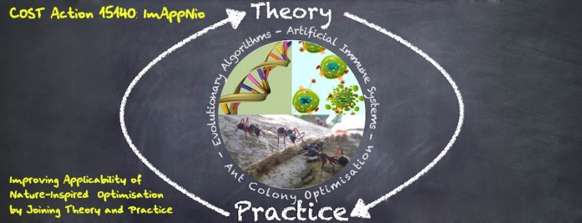

Unsupervised Machine Learning
Alberto TONDA, INRA(E), Université Paris-Saclay France

Slide 2
Unsupervised?
In supervised ML, training was labeled
We know the corresponding class of a sample
We know the value of a sample in regression
Unsupervised ML, there is no «ground truth»
We have data
We suspect there is exploitable regularity in data

Slide 3
Dimensionality Reduction
Very often, datasets have lots of features
If we take feature -> dimension
We cannot plot/understand more than 3!
Dimensionality reduction techniques
New features (combinations of existing features)
Make high-dimensional datasets readable

Slide 4
Principal Component Analysis
Classic and widely adopted
New features = linear combinations
Fit linear regression
Obtain hyperplane
Find other perpendicular hyperplanes

Slide 5
Example: PCAs
Dimensionality reduction + clustering
Stop at the first two plot
We took a dataset with 4 features (dimensions)
Visualized it in 2 dimensions
What do you notice? (second plot)

Slide 6
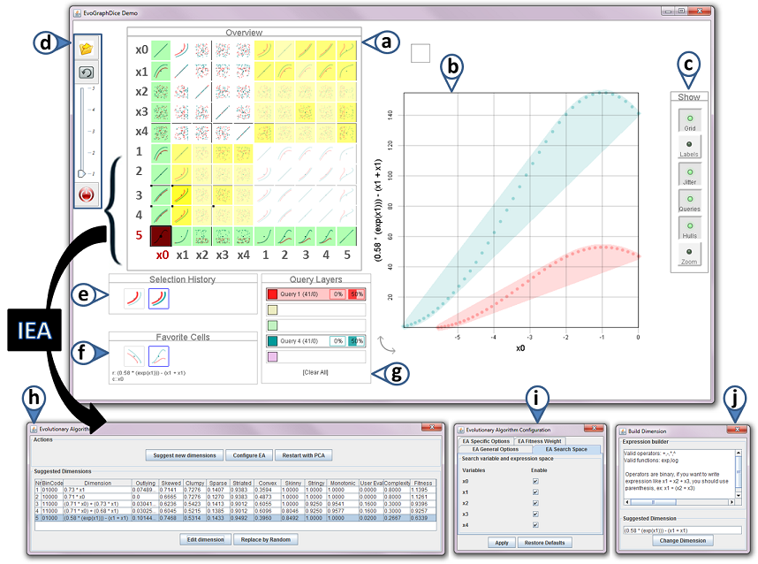
Interactive Evolutionary Dimensionality Reduction
EvoGraphDice
Uses Symbolic Regression to create dimensions
Feedback from the user (interactive)
Unfortunately, no demo
But there is a video!
https://aviz.fr/EVE

Slide 7
Clustering
We suspect there is some regularity in data
We do not have a ground truth
We ask an algorithm to aggregate «similar» samples in groups called «clusters»
Afterwards, we analyze clusters for sense

Slide 8
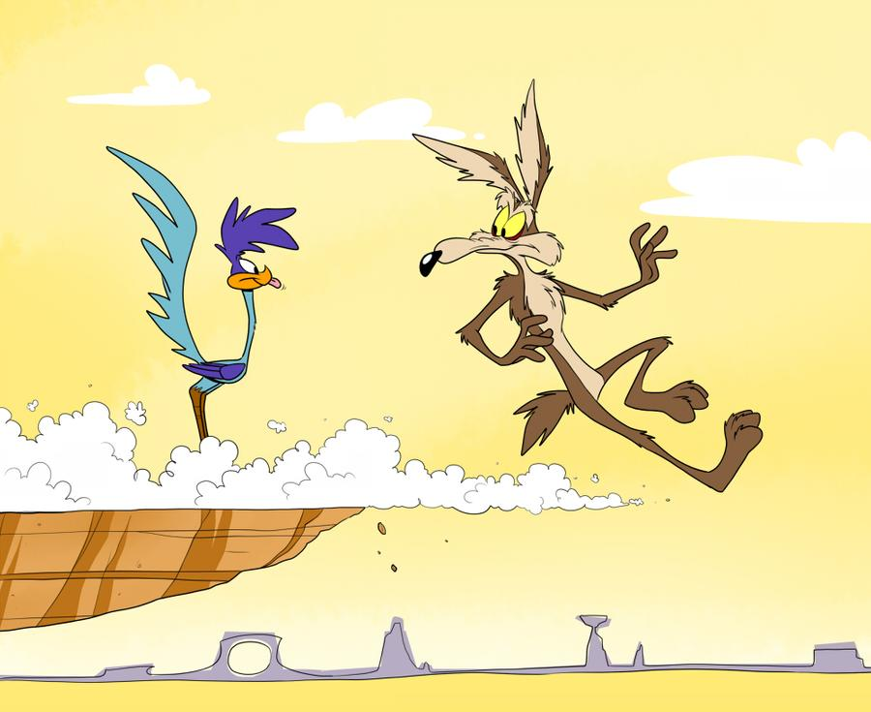
Clustering
Lots of (open) questions
What is «similar»? Close in feature space?
How many clusters do we expect?
What is a «good cluster»?
YOU
CLUSTERING
GROUND TRUTH

Slide 9
Example: Clustering
Let’s resume the previous example
Check the clustering results
Try other clustering algorithms
https://scikit-learn.org/stable/modules/clustering.html

Slide 10
Evolutionary Cluster Description
After obtaining clusters, describe them?
Find minimal set of rules that fully define cluster
Example from clustering malware
Large amounts of malware
Can be clustered together in «families»
Generate rules to identify them that cover most of the malware in the same cluster

Slide 11
Evolutionary Cluster Description
"Countering Android Malware: a Scalable Semi-Supervised Approach for Family-Signature Generation" Marcelli et al., 2019
https://github.com/jimmy-sonny/YaYaGen

